Slide 1
Unit 1: HTML & CSS:
WED DEVELOPMENT
3151606

Slide 2
What is HTML?
HTML stands for Hyper Text Markup Language
HTML is the standard markup language for creating Web pages
HTML describes the structure of a Web page
HTML consists of a series of elements
HTML elements tell the browser how to display the content
HTML elements label pieces of content such as "this is a heading", "this is a paragraph", "this is a link", etc.

Slide 3
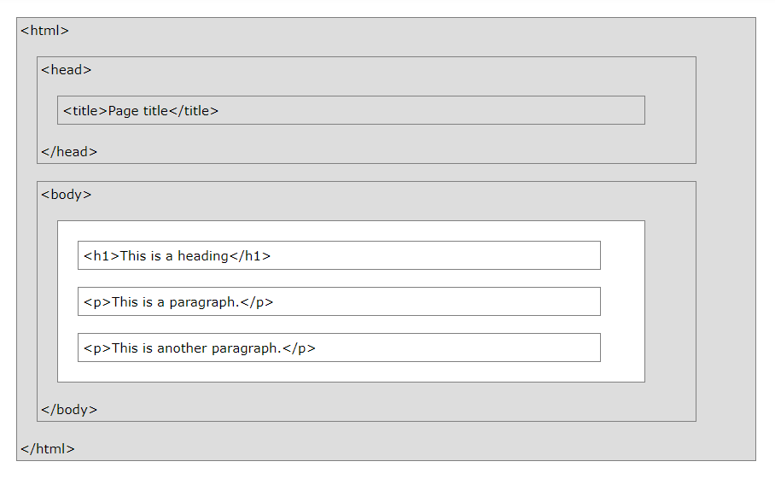
HTML Page Structure

Slide 4
A Simple HTML Document
<!DOCTYPE html> <html> <head> <title>Page Title</title> </head> <body> <h1>My First Heading</h1> <p>My first paragraph.</p> </body> </html>

Slide 5
Example Explained
The <!DOCTYPE html> declaration defines that this document is an HTML5 document
The <html> element is the root element of an HTML page
The <head> element contains meta information about the HTML page
The <title> element specifies a title for the HTML page (which is shown in the browser's title bar or in the page's tab)
The <body> element defines the document's body, and is a container for all the visible contents, such as headings, paragraphs, images, hyperlinks, tables, lists, etc.
The <h1> element defines a large heading
The <p> element defines a paragraph

Slide 6
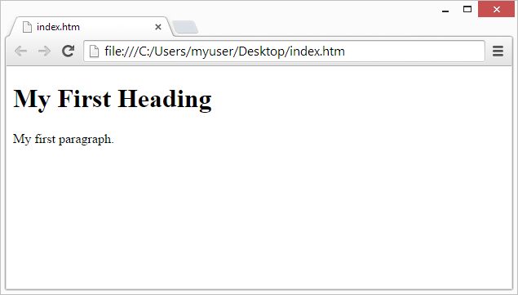
Web Browsers
The purpose of a web browser (Chrome, Edge, Firefox, Safari) is to read HTML documents and display them correctly.
A browser does not display the HTML tags, but uses them to determine how to display the document:

Slide 7
HTML Editors
Learn HTML Using Notepad or TextEdit
Web pages can be created and modified by using professional HTML editors.
However, for learning HTML we recommend a simple text editor like Notepad (PC) or TextEdit (Mac).
We believe in that using a simple text editor is a good way to learn HTML.
Follow the steps below to create your first web page with Notepad or TextEdit.

Slide 8
Step 1: Open Notepad (PC)
Windows 8 or later:
Open the Start Screen (the window symbol at the bottom left on your screen). Type Notepad.
Windows 7 or earlier:
Open Start > Programs > Accessories > Notepad

Slide 9
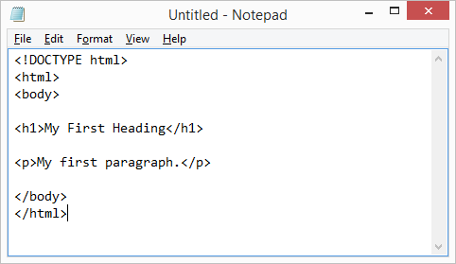
Step 2: Write Some HTML
<!DOCTYPE html> <html> <body> <h1>My First Heading</h1> <p>My first paragraph.</p> </body> </html>

Slide 10
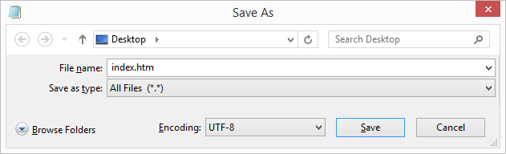
Step 3: Save the HTML Page
Save the file on your computer. Select File > Save as in the Notepad menu.
Name the file "index.htm" and set the encoding to UTF-8 (which is the preferred encoding for HTML files).

Slide 11

Step 4: View the HTML Page in Your Browser
Open the saved HTML file in your favorite browser (double click on the file, or right-click - and choose "Open with").
The result will look much like this:

Slide 12
HTML Elements
An HTML element is defined by a start tag, some content, and an end tag. <tagname>Content goes here...</tagname>
The HTML element is everything from the start tag to the end tag:
<h1>My First Heading</h1>
<p>My first paragraph.</p>

Slide 13
Nested HTML Elements
HTML elements can be nested (this means that elements can contain other elements).
All HTML documents consist of nested HTML elements.
The following example contains four HTML elements (<html>, <body>, <h1> and <p>):
<!DOCTYPE html> <html> <body> <h1>My First Heading</h1> <p>My first paragraph.</p> </body> </html>

Slide 14
To Remember
1. Never Skip the End Tag (e.g. <html> </html>
2. Empty HTML Elements (e.g <br>
3. HTML is Not Case Sensitive
4. HTML Tag Reference (Eg. H1 to h6: Define html headings)

Slide 15
HTML ATTRIBUTES
An HTML attribute provides additional information about an HTML element.
All HTML elements can have attributes
Attributes provide additional information about an element
Attributes are always specified in the start tag
Attributes usually come in name/value pairs like: name="value"

Slide 16
HTML links are defined with the <a> tag. The link address is specified in the href attribute:
<a href="https://www.w3schools.com">This is a link</a>
HTML images are defined with the <img> tag.
The filename of the image source is specified in the src attribute:
<img src="img_girl.jpg">
HTML images also have width and height attributes, which specifies the width and height of the image:
<img src="img_girl.jpg" width="500" height="600">

Slide 17
HTML PARAGRAPHS
The HTML <p> element defines a paragraph.
A paragraph always starts on a new line, and browsers automatically add some white space (a margin) before and after a paragraph.
EXAMPLE:
<p>This is a paragraph.</p> <p>This is another paragraph.</p>
<p> This paragraph contains a lot of lines in the source code, but the browser ignores it. </p>

Slide 18
HTML HEADING
HTML headings are titles or subtitles that you want to display on a webpage.
Heading 1
Heading 2
Heading 3
Heading 4
Heading 5
Heading 6

Slide 19
HTML headings are defined with the <h1> to <h6> tags.
<h1> defines the most important heading. <h6> defines the least important heading.
<h1>Heading 1</h1> <h2>Heading 2</h2> <h3>Heading 3</h3> <h4>Heading 4</h4> <h5>Heading 5</h5> <h6>Heading 6</h6>

Slide 20
BREAK RULE
The HTML <br> element defines a line break.
Use <br> if you want a line break (a new line) without starting a new paragraph:
<p>This is<br>a paragraph<br>with line breaks.</p>
The <br> tag is an empty tag, which means that it has no end tag.

Slide 21
HORIZONTAL RULES
The <hr> tag defines a thematic break in an HTML page, and is most often displayed as a horizontal rule.
The <hr> element is used to separate content (or define a change) in an HTML page:
<h1>This is heading 1</h1> <p>This is some text.</p> <hr> <h2>This is heading 2</h2> <p>This is some other text.</p> <hr>

Slide 22
COMMENTS
You can add comments to your HTML source by using the following syntax:
<!-- Write your comments here -->
Notice that there is an exclamation point (!) in the opening tag, but not in the closing tag
<!-- Do not display this image at the moment <img border="0" src="pic_trulli.jpg" alt="Trulli"> -->

Slide 23
HTML Formatting Elements
Formatting elements were designed to display special types of text:
<b> - Bold text
<strong> - Important text
<i> - Italic text
<em> - Emphasized text
<mark> - Marked text
<small> - Smaller text
<del> - Deleted text
<ins> - Inserted text
<sub> - Subscript text
<sup> - Superscript text

Slide 24
HTML <b> and <strong> Elements
The HTML <b> element defines bold text, without any extra importance.
<b>This text is bold</b>
The HTML <strong> element defines text with strong importance. The content inside is typically displayed in bold
<strong>This text is important!</strong>
HTML <i> and <em> Elements
The HTML <i> element defines a part of text in an alternate voice or mood. The content inside is typically displayed in italic.
<i>This text is italic</i>

Slide 25
The HTML <em> element defines emphasized text. The content inside is typically displayed in italic.
<em>This text is emphasized</em>
HTML <small> Element
The HTML <small> element defines smaller text
<small>This is some smaller text.</small>
HTML <mark> Element
The HTML <mark> element defines text that should be marked or highlighted:
<p>Do not forget to buy <mark>milk</mark> today.</p>

Slide 26
HTML <del> Element
The HTML <del> element defines text that has been deleted from a document. Browsers will usually strike a line through deleted text:
<p>My favorite color is <del>blue</del> red.</p>
HTML <ins> Element
The HTML <ins> element defines a text that has been inserted into a document. Browsers will usually underline inserted text:
<p>My favorite color is <del>blue</del> <ins>red</ins>.</p>

Slide 27
HTML <sub> Element
The HTML <sub> element defines subscript text. Subscript text appears half a character below the normal line, and is sometimes rendered in a smaller font. Subscript text can be used for chemical formulas, like H₂O.
<p>This is <sub>subscripted</sub> text.</p>
HTML <sup> Element
The HTML <sup> element defines superscript text. Superscript text appears half a character above the normal line, and is sometimes rendered in a smaller font. Superscript text can be used for footnotes, like WWW^{[1]}
<p>This is <sup>superscripted</sup> text.</p>

Slide 28
HTML Tables
HTML tables allow web developers to arrange data into rows and columns.
The <table> tag defines an HTML table.
Each table row is defined with a <tr> tag. Each table header is defined with a <th> tag. Each table data/cell is defined with a <td> tag.
By default, the text in <th> elements are bold and centered.
By default, the text in <td> elements are regular and left-aligned.

Slide 29
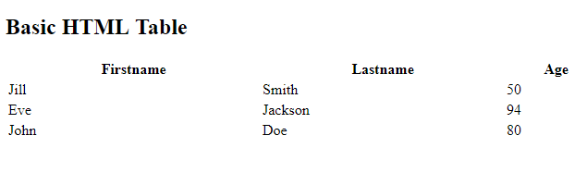
Table Example
<!DOCTYPE html>
<html>
<body>
<h2>Basic HTML Table</h2>
<table style="width:100%">
<tr>
<th>Firstname</th>
<th>Lastname</th>
<th>Age</th>
</tr>
<tr>
<td>Jill</td>
<td>Smith</td>
<td>50</td>
</tr>
<tr>
<td>Eve</td>
<td>Jackson</td>
<td>94</td>
</tr>
<tr>
<td>John</td>
<td>Doe</td>
<td>80</td>
</tr>
</table>
</body>
</html>

Slide 30
HTML Table – Column Span
To make a cell span more than one column, use the colspan attribute:
<table style="width:100%"> <tr> <th>Name</th> <th colspan="2">Telephone</th> </tr> <tr> <td>Bill Gates</td> <td>55577854</td> <td>55577855</td> </tr> </table>

Slide 31
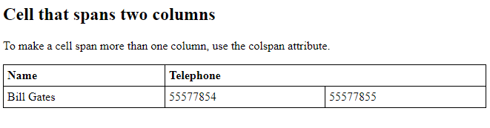
Colspan Example
<!DOCTYPE html>
<html>
<head>
<style>
table, th, td {
border: 1px solid black;
border-collapse: collapse;
}
th, td {
padding: 5px;
text-align: left;
}
</style>
</head>
<body>
<h2>Cell that spans two columns</h2>
<p>To make a cell span more than one column, use the colspan attribute.</p>
<table style="width:100%">
<tr>
<th>Name</th>
<th colspan="2">Telephone</th>
</tr>
<tr>
<td>Bill Gates</td>
<td>55577854</td>
<td>55577855</td>
</tr>
</table>
</body>
</html>

Slide 32
HTML Table – Row Span
To make a cell span more than one row, use the rowspan attribute:
<table style="width:100%"> <tr> <th>Name:</th> <td>Bill Gates</td> </tr> <tr> <th rowspan="2">Telephone:</th> <td>55577854</td> </tr> <tr> <td>55577855</td> </tr> </table>

Slide 33
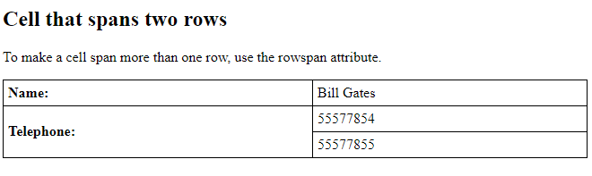
Rowspan Example
<!DOCTYPE html>
<html>
<head>
<style>
table, th, td {
border: 1px solid black;
border-collapse: collapse;
}
th, td {
padding: 5px;
text-align: left;
}
</style>
</head>
<body>
<h2>Cell that spans two rows</h2>
<p>To make a cell span more than one row, use the rowspan attribute.</p>
<table style="width:100%">
<tr>
<th>Name:</th>
<td>Bill Gates</td>
</tr>
<tr>
<th rowspan="2">Telephone:</th>
<td>55577854</td>
</tr>
<tr>
<td>55577855</td>
</tr>
</table>
</body>
</html>

Slide 34
HTML Links
Links are found in nearly all web pages. Links allow users to click their way from page to page.
HTML links are hyperlinks.
You can click on a link and jump to another document.
When you move the mouse over a link, the mouse arrow will turn into a little hand.
<a href="url">link text</a>

Slide 35
The most important attribute of the <a> element is the href attribute, which indicates the link's destination.
The link text is the part that will be visible to the reader.
Clicking on the link text, will send the reader to the specified URL address.
<a href="https://www.google.com/">Visit GOOGLE Link</a>
By default, links will appear as follows in all browsers:
An unvisited link is underlined and blue
A visited link is underlined and purple
An active link is underlined and red

Slide 36
Example of Link
<html>
<body>
<h1>HTML Links</h1>
<p><a href="https://www.google.com/">Visit google site, click here!</a></p>
</body>
</html>

Slide 37
HTML Links - The target Attribute
By default, the linked page will be displayed in the current browser window. To change this, you must specify another target for the link.
The target attribute specifies where to open the linked document.
The target attribute can have one of the following values:
_self – Default - Opens the document in the same window/tab as it was clicked
_blank - Opens the document in a new window or tab
_parent - Opens the document in the parent frame
_top - Opens the document in the full body of the window

Slide 38
Target Example
<html>
<body>
<h2>The target Attribute</h2>
<a href="https://www.google.com/" target="_blank"> Visit google site, click here!</a>
<p>If target="_blank", the link will open in a new browser window or tab.</p>
</body>
</html>

Slide 39
Absolute URLs vs. Relative URLs
Both examples above are using an absolute URL (a full web address) in the href attribute.
A local link (a link to a page within the same website) is specified with a relative URL (without the "https://www" part):
<h2>Absolute URLs</h2> <p><a href="https://www.w3.org/">W3C</a></p> <p><a href="https://www.google.com/">Google</a></p> <h2>Relative URLs</h2> <p><a href="html_images.asp">HTML Images</a></p> <p><a href="/css/default.asp">CSS Tutorial</a></p>

Slide 40
HTML Links - Use an Image as a Link

